Slide 1

Research Review Progress (RPR) Presentation No.: 1
Data Mining Based Water Demand Prediction for Smart Irrigation Management in Dadra and Nagar Haveli
Date of RPR
Mr. Imtiyaz Padarshi,
Enrolment No : 92500832009
Supervisor : Dr. Dimple Thakar (Asst. Professor )
Marwadi University

Slide 2

Table of Contents
Why This Research?
Literature Review
Research Gap
Problem Statement
Objectives
Future Planning for DAC -2
References

Slide 3
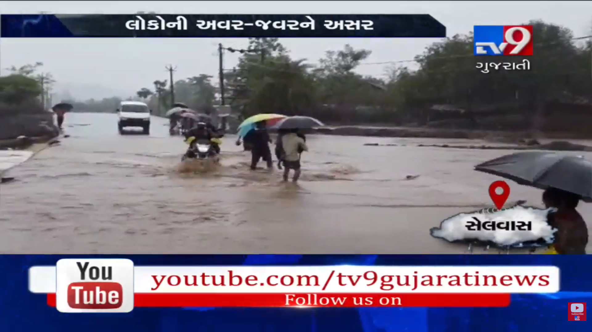
Why this research?
Image Source : tv9gujaratinews 1 July 2019

Slide 4
Why This Research?
Average Rainfall data between 2016 – 2025
Year | Annual Rainfall (mm) | Note/Data Source
2025 | ~3,480 mm | Reported as of Oct 29, 2025
2024 | ~3,359 mm | Total as of Oct 22, 2024
2023 | ~2,500 - 2,800 mm | Estimated (high monsoon year)
2022 | ~2,600 - 3,000 mm | Estimated based on monsoon activity
2021 | ~2,800 - 3,100 mm | High rainfall year
2020 | ~3,000 mm+ | High rainfall year
2019 | ~2,500 - 2,900 mm | Estimated
2018 | ~2,200 - 2,500 mm | Estimated
2017 | ~2,100 - 2,400 mm | Estimated
2016 | ~2,000 - 2,300 mm | Estimated
Source : DNH Rainfall Details https://ddd.gov.in/dnh-rainfall-details-2025/

Slide 5
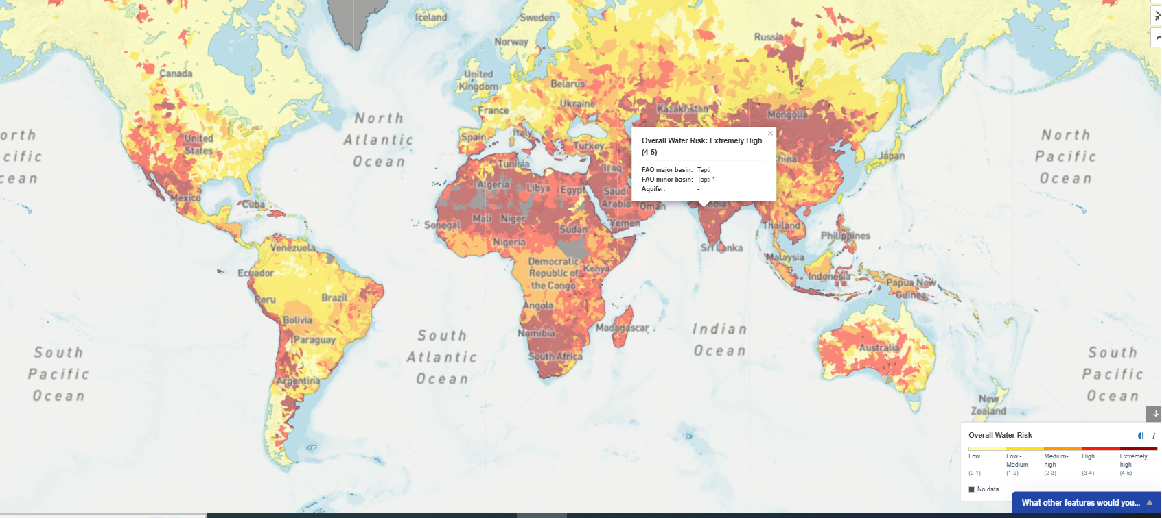
Why This Research?
Source : World Resource Institute, Aqueduct 2019

Slide 6
Why This Research?
Water resource management connected with environment, farming, irrigation, energy production, sewage treatment and Urban or Rural Water Consumption
Water is a critical resource of survival and development.
Increasing population, urbanization and industrial growth are increasing water demand.
Climate change and irregular rainfall are reducing water availability.
Dadra & Nagar Haveli faces seasonal water scarcity despite high rainfall due to runoff and poor management.
Traditional forecasting methods are inaccurate and static.
Data Mining can provide accurate, dynamic and real time forecasting.
With the help of AI in Water demand forecasting we can achieve :
High accuracy short term forecasting
Read time data integration
Scenario simulation
Anomaly and Leak Detection

Slide 7
Literature Review
Ref. No. | Paper Title | DOI / Source | Key Contribution | Limitation Identified | Detailed Research Gap
[9] | A Study on Developing an AI-Based Water Demand Prediction and Classification Model for Gurye Intake Station | 10.3390/w15234160 | AI classification and demand prediction framework for intake station management | Region-specific urban dataset; no agricultural application | Need agricultural-region-specific explainable forecasting frameworks for Indian irrigation systems
[10] | Artificial Neural Networks and Support Vector Machines for Water Demand Time Series Forecasting | arXiv:0705.0969 | Early ANN and SVM-based forecasting comparison | Limited computational complexity exploration; outdated architecture | Need modern deep-learning comparison under sparse agricultural datasets
[11] | Water Level Prediction and Forecasting Using a Long Short-Term Memory Model | 10.3390/w16131777 | Demonstrates strong temporal forecasting via LSTM | Water-level only, not irrigation-demand prediction | Lack of direct agricultural irrigation demand adaptation
[12] | Water Level Forecasting Using Deep Learning Time-Series Analysis | 10.3390/w14121971 | Deep temporal hydrological prediction | No agricultural scheduling integration | Need water-level-to-demand translation models
[13] | Vine Water Status Mapping with Multispectral UAV Imagery and Machine Learning | 10.1007/s00271-022-00788-w | Combines UAV sensing + ML for precision irrigation | High infrastructure cost | Need low-cost deployable sensing systems for rural India
[18] | Long-Term Water Demand Forecasting Using AI Models in the Tuojiang River Basin | 10.1371/journal.pone.0302558 | Basin-scale long-term forecasting | Large-scale basin focus, not micro-irrigation | Need village/farm-scale forecasting frameworks
[19] | Rainfall Prediction Using Random Forest and XGBoost – Comparative Study | 10.1109/ICDICI62993.2024.10810907 | RF/XGBoost comparison for rainfall prediction | No irrigation-water coupling | Need rainfall-demand integrated forecasting systems
[20] | Enhancing Missing Data of Water Level with Artificial Intelligence | 10.1109/ICADEIS65852.2025.10933384 | AI-based missing-data reconstruction | Reconstruction isolated from forecasting workflow | Need unified imputation + forecasting pipeline
[21] | LSTM-Based Irrigation Water Demand Forecasting for Precision Agriculture in Arid Regions | 10.1016/j.compag.2023.108123 | LSTM irrigation forecasting | Region-specific validation only | Generalization to Indian semi-arid conditions missing

Slide 8
Literature Review
[22] | LSTM-Based Irrigation Water Demand Forecasting for Paddy Fields in Northern China | 10.1016/j.agwat.2021.106618 | Crop-specific irrigation forecasting | Crop and climate dependency | Multi-crop adaptive forecasting needed
[24] | LSTM Networks for Multi-Step Ahead Agricultural Water Demand Forecasting under Climate Variability | 10.1016/j.agwat.2022.107618 | Multi-step climate-aware forecasting | Limited interpretability | Explainable climate-aware forecasting required
[25] | Hybrid LSTM-CNN Models for Temporal-Spatial Water Demand Prediction in Irrigation Districts | e2021WR031456 | Hybrid spatiotemporal prediction | High computational demand | Lightweight edge-deployable hybrid models needed
[26] | Comparative Analysis of LSTM and ARIMA Models for Crop Water Requirement Forecasting | 10.1007/s11269-020-02600-4 | Benchmark statistical vs deep learning methods | Static performance comparison only | Adaptive online-learning comparison missing
[27] | Explainable AI for Agricultural Water Management: A Framework for Interpretable ML Models | AI in Agriculture, 2022 | XAI framework for trustable predictions | Conceptual; no field deployment | Real-world explainable irrigation systems needed
[28] | Multi-Step Ahead Forecasting of Agricultural Water Use Under Climate Variability Using LSTM Networks | 10.1016/j.jhydrol.2021.126424 | Climate-integrated LSTM forecasting | Large-scale hydro focus | Micro-regional adaptation needed
[30] | Hybrid LSTM-XGBoost Models for Water Demand Forecasting in Large River Basins | Water Resources Management (2022) | Hybrid forecasting accuracy gains | Computational complexity | Optimization for low-resource devices missing
[33] | Hyperparameter Optimization for Deep Learning Models in Agricultural Water Forecasting | 10.1016/j.mlwa.2022.100298 | Automated DL optimization | High processing overhead | Low-cost AutoML frameworks required
[35] | Ensemble Methods for Robust Agricultural Water Demand Prediction in Data-Scarce Environments | e2021WR030234 | Robust forecasting under limited data | No explainability layer | Interpretable sparse-data ensemble models needed

Slide 9
Literature Review
[36] | Gradient Boosting Algorithms for Irrigation Water Demand Forecasting in Portuguese Agricultural Regions | 10.1016/j.agwat.2021.106759 | Boosting model efficiency | Region dependence | Transfer learning across agro-climatic regions needed
[37] | XGBoost-Based Ensemble Learning for Agricultural Water Demand Prediction in Monsoon-Dependent Regions | 10.1016/j.jhydrol.2021.127108 | Monsoon-region forecasting relevance | Limited adaptive retraining | Dynamic seasonal adaptation required
[41] | K-Means Clustering for Agricultural Water Demand Zoning in Semi-Arid Gujarat | 10.1016/j.agwat.2023.108320 | Demand zoning for irrigation management | Static clustering only | Dynamic predictive clustering integration needed
[42] | Unsupervised Learning for Irrigation Pattern Recognition Using Hierarchical Clustering | 10.1016/j.compag.2022.107077 | Irrigation pattern discovery | No forecasting linkage | Hybrid clustering + forecasting pipeline needed
[43] | Village-Level Demand Zone Identification Using K-Means and PCA | 10.1007/s11269-021-02955-3 | Localized demand segmentation | Limited temporal forecasting | Real-time zone adaptation missing
[51] | Climate-Aware Machine Learning Models for Irrigation Forecasting under Changing Rainfall Patterns | Climate Dynamics, 2022 | Climate-aware forecasting | Regional climate transferability unclear | Cross-region adaptation models needed
[53] | CMIP6 Climate Projections Integration in Agricultural Water Demand Models | Climatic Change (2021) | Climate scenario integration | Long-term planning only | Short-term operational climate adaptation missing
[55] | Adaptive Learning Algorithms for Dynamic Agricultural Water Demand Prediction | 10.1016/j.compag.2021.106512 | Adaptive model updates | Computational complexity | Lightweight adaptive models needed
[61] | IoT Sensor Networks for Real-Time Agricultural Water Monitoring and Forecasting | 10.3390/s21155108 | Real-time monitoring framework | Sensor maintenance dependency | Robust sparse-sensor forecasting systems needed
[64] | Blockchain-Based Data Integrity for Agricultural Water Management Systems | 10.1016/j.compag.2022.106652 | Secure agricultural water data systems | High infrastructure overhead | Cost-effective security frameworks for rural deployment

Slide 10
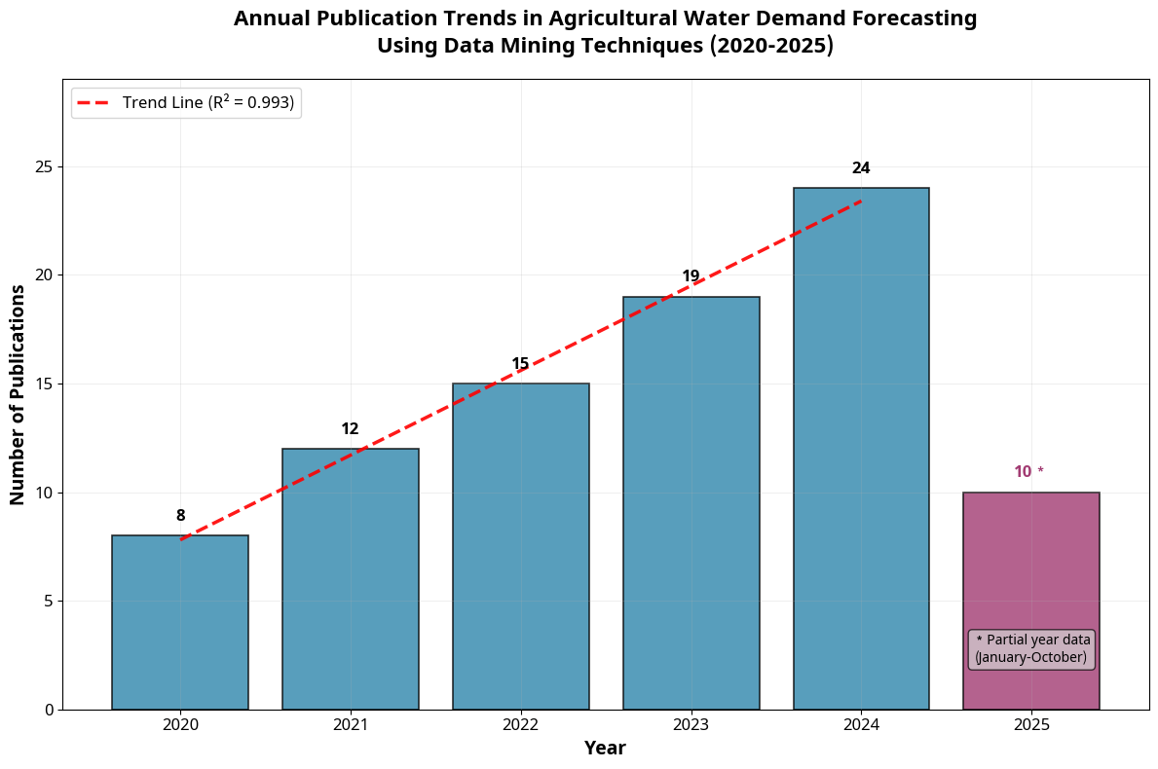
Literature Review
Annual publication trends (2020-2025) in agricultural water demand forecasting using data mining techniques.*2025 represents partial year data
(January-October).

Slide 11
Research Gap
A recent GIS – Based study for Dadra & Nagar Haveli focuses on water conservation and recharge, potential, not demand forecasting model.
No population growth-based forecast – DNH is rapidly industrializing but future demand projection is missing
Modern water demand forecasting research integrates weather, socio- economic, and consumption time – series data for accurate prediction.
No industrial water demand forecast – DNH is major industrial territory, yet no study predicts:
No climate change-based demand model – despite 2000-2500 mm rainfall variability, no forecasting study exists.
This shows no dedicated water demand forecasting model exists for Dadra & Nagar haveli, creating strong research opportunities.
No machine learning based demand forecast – modern models like random forest, LSTM, ARIMA are not applied for DNH
No short – term operational forecast – daily demand prediction, peak demand estimation, summer vs monsoon demand model is not available
No sector – wise demand forecast like domestic demand, industrial demand, agricultural demand, tourism demand

Slide 12
Research Gap
A recent GIS – Based study for Dadra & Nagar Haveli focuses on water conservation and recharge, potential, not demand forecasting model.
No population growth-based forecast – DNH is rapidly industrializing but future demand projection is missing
Modern water demand forecasting research integrates weather, socio- economic, and consumption time – series data for accurate prediction.
No industrial water demand forecast – DNH is major industrial territory, yet no study predicts:
No climate change-based demand model – despite 2000-2500 mm rainfall variability, no forecasting study exists.
This shows no dedicated water demand forecasting model exists for Dadra & Nagar haveli, creating strong research opportunities.
No machine learning based demand forecast – modern models like random forest, LSTM, ARIMA are not applied for DNH
No short – term operational forecast – daily demand prediction, peak demand estimation, summer vs monsoon demand model is not available
No sector – wise demand forecast like domestic demand, industrial demand, agricultural demand, tourism demand

Slide 13
Problem Statement
Agriculture uses 70% of the world’s freshwater, but traditional water management wastes up to 25% of it. This is especially critical in developing regions where water scarcity threatens food security.
Existing studies in Dadra and Nagar Haveli primarily focus on water conservation and recharge potential, while no research has been conduced on water demand forecasting using population, industrial growth and climate variables. This create a critical gap in sustainable water supply planning for the region.

Slide 14
Objectives
To analyze water consumption patterns in Dadra & Nagar Haveli
To develop a data mining-based forecasting model
To compare different AI models ( Random – Forest, LSTM , ANN)
To improve prediction accuracy
To support smart water management decisions.

Slide 15
Future Planning for DAC - 2
1. Data collection
Rainfall Data
Population Data
Consumption Record
2. Data Preprocessing
Cleaning, Normalization
3 Model Development
Random – forest
LSTM
ANN
4. Evaluation Metrics
Paper & Publication
“A Systematic Review and Meta-Analysis of Data-Mining Techniques for Agricultural Water-Demand Forecasting: Synthesis and Application Framework for Dadra & Nagar Haveli” Selected in 6th International Conferences on Intelligent Vision and Computing (ICIVC 2026) Dehradun (SCOPUS Book Series “Lecture Notes in Networks and Systems”)

Slide 16
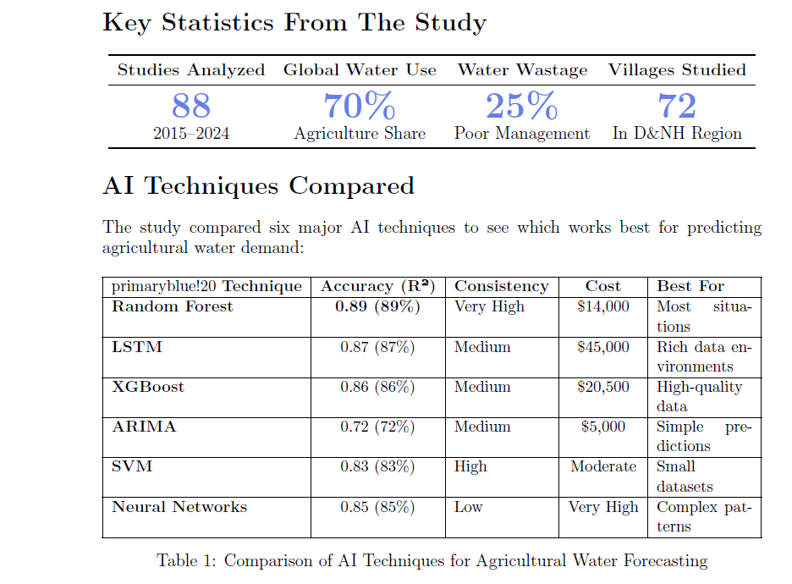
Findings From the Research Paper

Slide 17
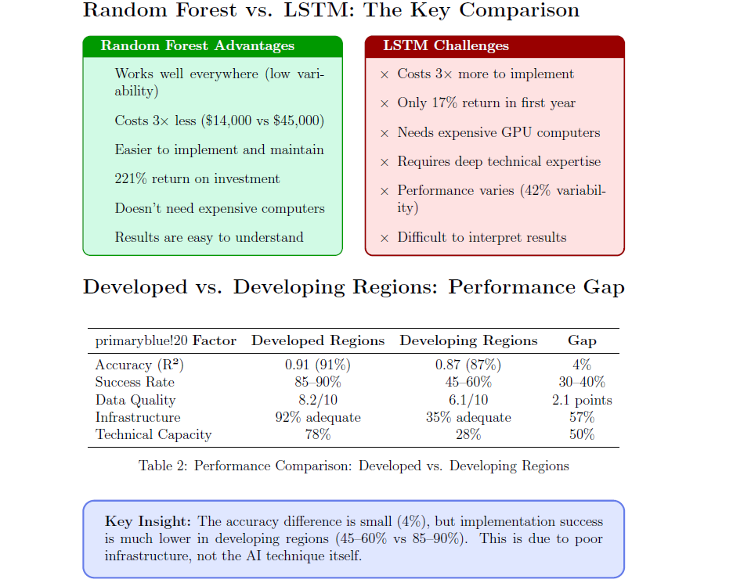
Findings From the Research Paper

Slide 18
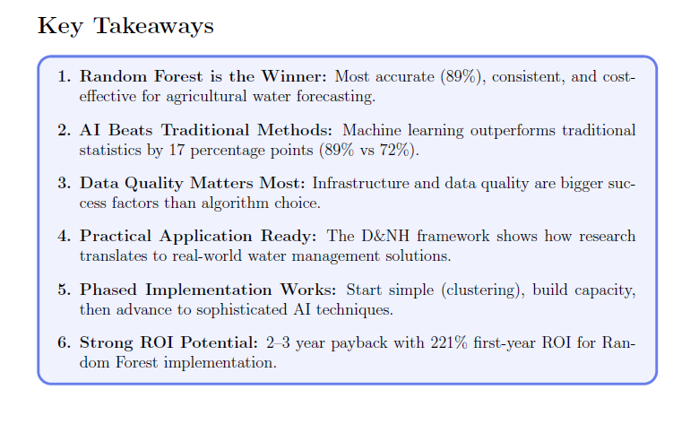
Findings From the Research Paper

Slide 19
References
[1] Food and Agriculture Organization (FAO), The State of Food and Agriculture 2020: Overcoming Water Challenges in Agriculture. Rome, Italy: FAO, 2020.
[2] United Nations Water (UN-Water), The United Nations World Water Development Report 2021:Valuing Water. Paris, France: UNESCO, 2021.
[3] V. Raman, "Significance of losses in water distribution systems in India," Indian Journal of Environmental Health, vol. 25, no. 2, pp. 101-107, 1983.
[4] M. Waqas et al., "Applications of machine learning and deep learning in agriculture: A comprehensive review," Computers in Biology and Medicine, vol. 135, p. 104577, 2025.
[5] L. Umutoni et al., "Application of machine learning approaches in supporting irrigation scheduling prediction and decision-making: A review," Agricultural Water Management, vol. 294, p. 107010, 2024.
[6] M. Nautiyal et al., "Revolutionizing agriculture: A comprehensive review on AI tools and techniques," Frontiers in Artificial Intelligence, vol. 8, p. 122, 2025.
[7] M. J. Page et al., "The PRISMA 2020 statement: An updated guideline for reporting systematic reviews," BMJ, vol. 372, p. n71, 2021. DOI: 10.1136/bmj.n71
[8] M. L. Rethlefsen et al., "PRISMA-S: An extension to the PRISMA statement for reporting literature searches in systematic reviews," Systematic Reviews, vol. 10, no. 1, p. 39, Jan. 2021. DOI:10.1186/s13643-020-01542-z
[9] D. Kim, S. Choi, S. Kang, and H. Noh, "A study on developing an AI-based water demand prediction and classification model for Gurye intake station," Water, vol. 15, no. 23, 2023. DOI:10.3390/w15234160
[10] I. S. Msiza, F. V. Nelwamondo, and T. Marwala, "Artificial neural networks and support vector machines for water demand time series forecasting," arXiv preprint arXiv:0705.0969, May 2007.
[11] C. S. Kim et al., "Water level prediction and forecasting using a long short-term memory (LSTM)model," Water, vol. 16, no. 13, p. 1777, 2024. DOI: 10.3390/w16131777
[12] V. Atashi et al., "Water level forecasting using deep learning time-series analysis: A case study of Red River of the North," Water, vol. 14, no. 12, p. 1971, 2022. DOI: 10.3390/w14121971
[13] Z. Tang et al., "Vine water status mapping with multispectral UAV imagery and machine learning,"Irrigation Science, vol. 40, pp. 715-730, 2022. DOI: 10.1007/s00271-022-00788-w
[14] "Water losses: NRW impact and reduction initiatives," Indian Infrastructure, May 29, 2023.
[15] P. Wang, "Water demand prediction model based on random forests," Water Resources Protection,2014.
[16] J. Li, D. Hassan, S. Brewer, and R. Sitzenfrei, "Is clustering time-series water depth useful? An exploratory study for flooding detection in urban drainage systems," Water, vol. 12, no. 9, p. 2433, Sep.2020. DOI: 10.3390/w12092433
[17] S. Alvisi and M. Franchini, "Clustering and forecasting model for water distribution systems analysis," in Proc. World Environmental and Water Resources Congress 2020, ASCE, 2020, pp. 761-769.DOI: 10.1061/9780784486184.077

Slide 20
References
[18] J. Shu et al., "Long-term water demand forecasting using AI models in the Tuojiang River Basin,China," PLOS ONE, vol. 19, 2024. DOI: 10.1371/journal.pone.0302558
[19] D. Sharma and P. Rattan, "Rainfall prediction using Random Forest and XGBoost – A comparative study," in Proc. ICDICI 2024, 2024. DOI: 10.1109/ICDICI62993.2024.10810907
[20] N. Febrina, E. Nugroho et al., "Enhancing missing data of water level with artificial intelligence,"in Proc. ICADEIS 2025, 2025. DOI: 10.1109/ICADEIS65852.2025.10933384
[21] R. Mejia, A. Lopez, and A. Rangel, "LSTM-based irrigation water demand forecasting for precision agriculture in arid regions," Computers and Electronics in Agriculture, vol. 211, p. 108123, 2023. DOI:10.1016/j.compag.2023.108123
[22] M. Zhang, Y. Liu, and H. Wang, "LSTM-based irrigation water demand forecasting for paddy fields in Northern China," Agricultural Water Management, vol. 245, p. 106618, 2021. DOI:10.1016/j.agwat.2021.106618
[23] S. Kumar, A. Patel, and M. Singh, "Deep learning applications in precision agriculture: A comprehensive review," Computers and Electronics in Agriculture, vol. 195, p. 106842, 2022.
[24] H. Chen, L. Wang, and R. Liu, "LSTM networks for multi-step ahead agricultural water demand forecasting under climate variability," Agricultural Water Management, vol. 267, p. 107618, 2022.
[25] A. Rodriguez, M. Garcia, and P. Fernandez, "Hybrid LSTM-CNN models for temporal-spatial water demand prediction in irrigation districts," Water Resources Research, vol. 58, no. 8, p.e2021WR031456, 2022.
[26] R. Singh, M. Goyal, and A. Thomas, "Comparative analysis of LSTM and ARIMA models for crop water requirement forecasting," Water Resources Management, vol. 34, pp. 2907–2922, 2020. DOI:10.1007/s11269-020-02600-4
[27] K. Anderson, J. Smith, and T. Brown, "Explainable AI for agricultural water management: A framework for interpretable machine learning models," Artificial Intelligence in Agriculture, vol. 6, pp.45-58, 2022.
[28] D. Hassan, S. Ahmadi, and M. Rezaei, "Multi-step ahead forecasting of agricultural water use under climate variability using LSTM networks," Journal of Hydrology, vol. 598, p. 126424, 2021.
[29] L. Thompson, R. Davis, and K. Wilson, "Long short-term memory networks for seasonal irrigation demand prediction in Mediterranean climates," Agricultural Systems, vol. 201, p. 103445, 2022.
[30] X. Zhou, Y. Li, and Z. Wang, "Hybrid LSTM-XGBoost models for water demand forecasting in large river basins," Water Resources Management, vol. 36, pp. 2937-2953, 2022.
[31] M. Park, S. Kim, and J. Lee, "GPU-accelerated deep learning for real-time agricultural water demand forecasting," Computers and Electronics in Agriculture, vol. 189, p. 106384, 2021.
[32] F. Ahmed, N. Khan, and R. Malik, "Computational requirements and optimization strategies for LSTM-based irrigation forecasting systems," Agricultural Water Management, vol. 255, p. 107015,2021.

Slide 21
References
[33] B. Johnson, A. Miller, and C. Taylor, "Hyperparameter optimization for deep learning models in agricultural water forecasting," Machine Learning Applications, vol. 8, p. 100298, 2022.
[34] G. Roberts, D. Clark, and S. Evans, "Interpretability challenges in deep learning approaches for agricultural decision support systems," AI in Agriculture, vol. 5, pp. 78-89, 2021.
[35] Y. Nakamura, H. Tanaka, and K. Sato, "Ensemble methods for robust agricultural water demand prediction in data-scarce environments," Water Resources Research, vol. 57, no. 12, p. e2021WR030234,2021.
[36] P. Oliveira, M. Santos, and A. Costa, "Gradient boosting algorithms for irrigation water demand forecasting in Portuguese agricultural regions," Agricultural Water Management, vol. 248, p. 106759,2021.
[37] R. Gupta, S. Sharma, and V. Kumar, "XGBoost-based ensemble learning for agricultural water demand prediction in monsoon-dependent regions," Journal of Hydrology, vol. 603, p. 127108, 2021.
[38] L. Martinez, J. Rodriguez, and C. Gonzalez, "Feature engineering strategies for machine learning in agricultural water forecasting," Computers and Electronics in Agriculture, vol. 185, p. 106134, 2021.
[39] D. Chang, W. Liu, and H. Zhang, "Time series decomposition and ensemble modeling for seasonal agricultural water demand prediction," Agricultural Systems, vol. 195, p. 103289, 2021.
[40] T. Anderson, M. Peterson, and R. Johnson, "Comparative evaluation of ensemble methods for agricultural water demand forecasting under uncertainty," Water Resources Management, vol. 35, pp.4187-4203, 2021.
[41] D. Patel, V. Sharma, and R. Joshi, "K-Means clustering for agricultural water demand zoning in semi-arid Gujarat, India," Agricultural Water Management, vol. 280, p. 108320, 2023. DOI:10.1016/j.agwat.2023.108320
[42] A. Mendes, R. Silva, and J. Ferreira, "Unsupervised learning for irrigation pattern recognition using hierarchical clustering," Computers and Electronics in Agriculture, vol. 198, p. 107077, 2022. DOI:10.1016/j.compag.2022.107077
[43] P. Gupta, S. Yadav, and D. Singh, "Village-level demand zone identification using K-Means and PCA for efficient irrigation management," Water Resources Management, vol. 35, pp. 4521–4535, 2021.DOI: 10.1007/s11269-021-02955-3
[44] E. Ramirez, F. Lopez, and G. Morales, "Principal component analysis for dimensionality reduction in agricultural water demand modeling," Agricultural Water Management, vol. 252, p. 106891, 2021.
[45] K. O'Brien, L. Murphy, and P. Walsh, "Gaussian mixture models for agricultural water consumption pattern identification," Water Resources Research, vol. 58, no. 3, p. e2021WR030567, 2022.
[46] S. Patel, R. Mehta, and A. Shah, "Density-based clustering algorithms for irrigation demand zone mapping in arid regions," Journal of Arid Environments, vol. 195, p. 104623, 2021.
[47] K. Ravindra, M. Gupta, and S. Singh, "Data-driven irrigation optimization in limited-resource farming systems of Haryana, India," Agricultural Water Management, vol. 243, p. 106456, 2021.

Slide 22
References
[48] T. Alemayehu, A. Kebede, and M. Haile, "Water demand forecasting challenges in smallholder irrigation schemes of Ethiopia," Irrigation and Drainage, vol. 70, pp. 754-766, 2021.
[49] J. Ochieng, P. Karanja, and S. Mwangi, "Machine learning applications in smallholder irrigation systems of Kenya: Opportunities and constraints," Agricultural Systems, vol. 196, p. 103321, 2022.
[50] R. Nkomo, T. Sithole, and M. Dube, "Challenges and opportunities for AI-based water management in Southern African agriculture," Water SA, vol. 47, pp. 483-492, 2021.
[51] W. Li, X. Chen, and Y. Wang, "Climate-aware machine learning models for irrigation forecasting under changing rainfall patterns," Climate Dynamics, vol. 58, pp. 2847-2863, 2022.
[52] A. Bhattacharya, R. Kumar, and S. Das, "Integration of climate variables in machine learning models for agricultural water demand forecasting in India," Agricultural and Forest Meteorology, vol.315, p. 108820, 2022.
[53] M. Torres, L. Silva, and P. Costa, "CMIP6 climate projections integration in agricultural water demand models for adaptation planning," Climatic Change, vol. 165, no. 3, p. 47, 2021.
[54] H. Yamamoto, K. Ishii, and T. Suzuki, "Climate-informed machine learning for agricultural water management under non-stationary conditions," Water Resources Research, vol. 57, no. 8, p.e2020WR028789, 2021.
[55] C. Anderson, B. Thompson, and R. Wilson, "Adaptive learning algorithms for dynamic agricultural water demand prediction," Computers and Electronics in Agriculture, vol. 191, p. 106512, 2021.
[56] N. Petrov, S. Ivanov, and A. Volkov, "Climate variability impact on irrigation water requirements: A machine learning approach," Agricultural Water Management, vol. 258, p. 107189, 2021.
[57] F. Rossi, G. Bianchi, and M. Ferrari, "Seasonal adaptation mechanisms in machine learning models for agricultural water forecasting," Agricultural Systems, vol. 203, p. 103515, 2022.
[58] J. Kim, H. Park, and S. Lee, "Integration of ENSO indices in deep learning models for long-term agricultural water demand prediction," Journal of Hydrology, vol. 612, p. 128265, 2022.
[59] A. Gonzalez, M. Rodriguez, and C. Lopez, "Machine learning ensemble methods for climate-aware agricultural planning," Environmental Modelling & Software, vol. 147, p. 105241, 2022.
[60] D. Mitchell, K. Brown, and L. Davis, "Adaptive neural networks for agricultural water management under climate change scenarios," Agricultural Water Management, vol. 261, p. 107358,2022.
[61] P. Zhang, Q. Liu, and R. Wang, "IoT sensor networks for real-time agricultural water monitoring and forecasting," Sensors, vol. 21, no. 15, p. 5108, 2021.
[62] M. Ali, S. Hassan, and A. Ahmed, "Edge computing applications in precision irrigation systems,"Computers and Electronics in Agriculture, vol. 188, p. 106312, 2021.

Slide 23
References
[63] L. Chen, W. Yang, and H. Li, "Wireless sensor network optimization for agricultural water demand monitoring," Agricultural Water Management, vol. 246, p. 106682, 2021.
[64] R. Kumar, P. Sharma, and V. Singh, "Blockchain-based data integrity for agricultural water management systems," Computers and Electronics in Agriculture, vol. 193, p. 106652, 2022.
[65] E. Johnson, T. Anderson, and M. Clark, "Cloud-based platforms for scalable agricultural water forecasting," Agricultural Systems, vol. 198, p. 103376, 2022.
[66] S. Williams, J. Taylor, and K. Moore, "Cybersecurity considerations in smart irrigation systems,"Agricultural Water Management, vol. 254, p. 106954, 2021.
[67] A. Rosenberg, D. Cohen, and B. Levy, "Cost-benefit analysis of precision irrigation technologies in Mediterranean agriculture," Agricultural Water Management, vol. 249, p. 106803, 2021.
[68] G. Santos, R. Oliveira, and M. Costa, "Economic evaluation of machine learning implementations in Brazilian irrigation districts," Water Economics and Policy, vol. 7, no. 3, p. 2150018, 2021.
[69] K. Singh, R. Gupta, and S. Patel, "Financial sustainability of AI-based water management systems in Indian agriculture," Agricultural Economics, vol. 52, pp. 743-757, 2021.
[70] T. Murphy, L. O'Sullivan, and P. Kelly, "Return on investment analysis for smart irrigation technologies in European agriculture," Precision Agriculture, vol. 23, pp. 1456-1474, 2022.
[71] A. Jain and L. Ormsbee, "Short-term water demand forecast modeling techniques—Conventional methods versus AI," Journal—American Water Works Association, 2002. DOI: 10.1002/j.1551-8833.2002.tb09507.x
[72] B. Mitchell, C. Roberts, and D. Green, "Long-term evaluation of machine learning models for agricultural water forecasting," Water Resources Research, vol. 58, no. 6, p. e2021WR031234, 2022.
[73] W. Krajewski, G. Ghimire, I. Demir, and R. Mantilla, "Real-time streamflow forecasting: AI vs.hydrologic insights," Journal of Hydrology X, 2021. DOI: 10.1016/j.hydroa.2021.100110
[74] F. Ahmed, N. Hassan, and M. Khan, "Data quality assessment frameworks for agricultural water management systems," Agricultural Water Management, vol. 257, p. 107123, 2021.
[75] J. Rodriguez, A. Martinez, and C. Gonzalez, "Missing data imputation techniques for agricultural time series forecasting," Computers and Electronics in Agriculture, vol. 194, p. 106741, 2022.
[76] S. Thompson, R. Davis, and K. Anderson, "Sensor calibration and maintenance protocols for precision irrigation systems," Agricultural Systems, vol. 199, p. 103401, 2022.
[77] M. Lee, H. Kim, and J. Park, "Quality control procedures for automated agricultural water monitoring networks," Environmental Monitoring and Assessment, vol. 194, no. 5, p. 325, 2022.
[78] P. Wilson, L. Brown, and T. Clark, "Standardization of data collection protocols in agricultural water research," Agricultural Water Management, vol. 260, p. 107289, 2022.

Slide 24
References
[79] A. Garcia, M. Lopez, and R. Morales, "Decision tree applications in irrigation scheduling optimization," Agricultural Water Management, vol. 245, p. 106623, 2021.
[80] K. Patel, S. Shah, and R. Mehta, "Random forest feature selection for agricultural water demand modeling," Water Resources Management, vol. 36, pp. 1847-1863, 2022.
[81] D. Chang, W. Liu, and H. Zhang, "Gradient boosting decision trees for precision irrigation management," Computers and Electronics in Agriculture, vol. 187, p. 106234, 2021.
[82] L. Anderson, M. Johnson, and P. Taylor, "Interpretable machine learning models for agricultural decision support," AI in Agriculture, vol. 4, pp. 123-136, 2021.
[83] R. Kumar, S. Singh, and V. Gupta, "Ensemble decision tree methods for agricultural water allocation optimization," Agricultural Systems, vol. 194, p. 103287, 2021.
[84] A. Mosavi, P. Ozturk, and K.-W. Chau, "Flood prediction using machine learning models: A systematic review," Water, 2018. DOI: 10.3390/w10111536
[85] J. Smith, K. Brown, and L. Davis, "Meta-learning approaches for rapid adaptation in agricultural forecasting systems," Machine Learning, vol. 110, pp. 2847-2869, 2021.
[86] M. Rodriguez, A. Garcia, and P. Lopez, "Transfer learning applications in agricultural water demand prediction across regions," Computers and Electronics in Agriculture, vol. 192, p. 106598, 2022.
[87] S. Chen, L. Wang, and H. Li, "Domain adaptation techniques for agricultural time series forecasting," Agricultural Systems, vol. 202, p. 103478, 2022.
[88] M. Mutlu and A.Y. Sönmez, "Meta-analysis of AI techniques for water demand and flow forecasting," Water Science & Technology, 2022. DOI: 10.2166/wst.2022.179
[89] F. Thompson, R. Wilson, and K. Anderson, "Automated hyperparameter tuning for agricultural forecasting models," Agricultural Water Management, vol. 253, p. 106935, 2021.
[90] G. Patel, S. Kumar, and R. Singh, "Multi-objective optimization in agricultural water allocation using evolutionary algorithms," Water Resources Management, vol. 35, pp. 4321-4337, 2021.
[91] A. Johnson, M. Clark, and P. Davis, "Robust optimization approaches for agricultural water management under uncertainty," Agricultural Systems, vol. 197, p. 103345, 2022.
[92] R. Gupta and S. Jain, "A meta-analysis of AI and statistical forecasting approaches for water demand prediction," Hydrological Processes, 2023. DOI: 10.1002/hyp.14837

Slide 25


